Slide 1
Fraudulent Job Postings
Brennan Orgeron, Rommel Hernandez, David Jowers, Jordan Morrison

Slide 2

The Issue
Fake job posting have become a growing issue in the recent years.
There has been an increase in fake job postings year over year, and with the increase in available remote jobs, this number will continue to rise.
These postings aim to steal personal information in order to either sell that information or use it for fraudulent activities.

Slide 3
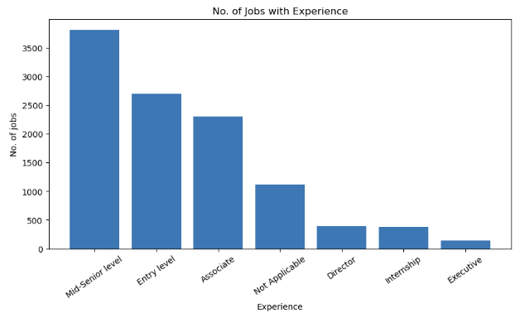
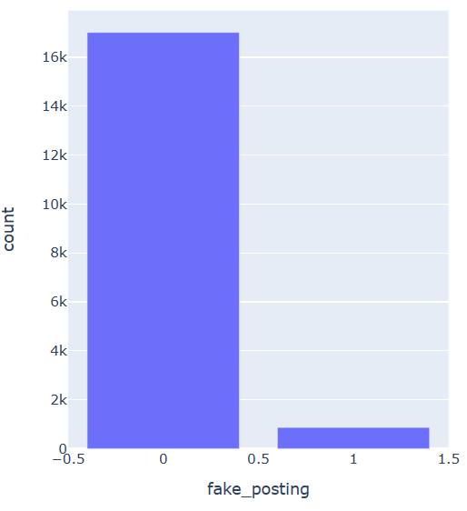
Data
We have a collection of data from over 17,000 job postings.
This data includes various details such as:
Salary Range
Job description
Requirements
functions & more
Had minimal missing values.
Good data, but overrepresentation of real jobs

Slide 4
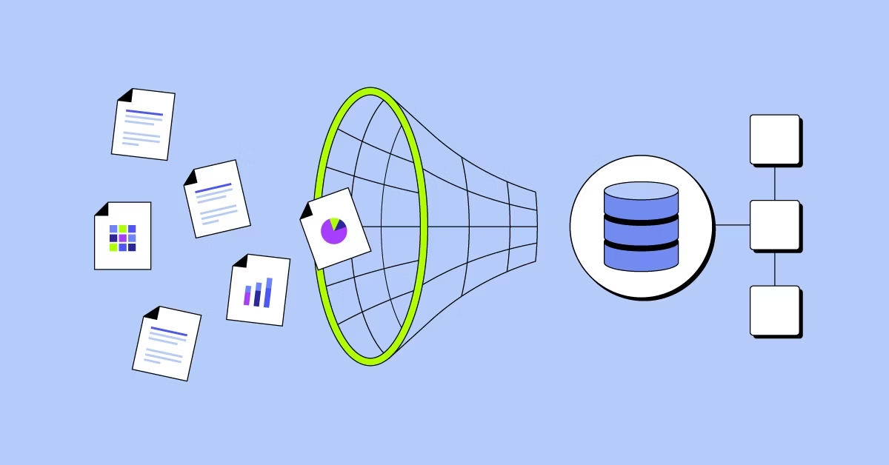
How We Wrangled Data
Missing Values
Replaced all missing values with NaN
Rename Columns:
Renamed columns to appropriate names
Redundant Information:
Dropped any columns with redundant or irrelevant information

Slide 5
What Where Some Promising Models?
The four most promising models we found where:
Linear Regression
Random Forest
Decision Tree
Nearest Neighbor

Slide 6

Why Decision Tree?
High Accuracy score
With a score of 53% we are able to warn people that a posting is most likely fraudulent
Easy Model To Explain
Thrives in True False scenario
(fraudulent True or False)

Slide 7

Findings
5% of all posting where fraudulent
Most common fraudulent jobs:
Remote Data Entry Admin
Remote Data Entry Clerk
Cruise Staff
Can see Remote/Travel jobs are leading types of fraudulent postings

Slide 8

Findings (ML)
Initial models with continuous (binary) data had relatively poor accuracy results
We further narrow down variables to include in model and convert to numeric data
Using dummy variables improved linear regression but there is evidence of overfitting for nearest neighbor , decision tree and random forest
Possible unbalanced target variable leading to the overfitting

Slide 9

What We Learned
Different ways of using machine learning
How to know what methods provide best results
How to use Python to identify important variables
How to split into training and testing sets

